Slide 1
EVSE 4
Electric Vehicle Supply Equipment (EVSE)
Codes, Standards and Applications

Slide 2
History of the EV and EVSE
Industry Development and Growth
Industry Codes and Standards
Charging Opportunities and Challenges
Range and Charging Options
Metrological Concerns
Inlet Placement / Connector Style
EVSE Location and Placement
Requirements of the National Electrical Code
Frequently Asked Questions on EVSE

Slide 3
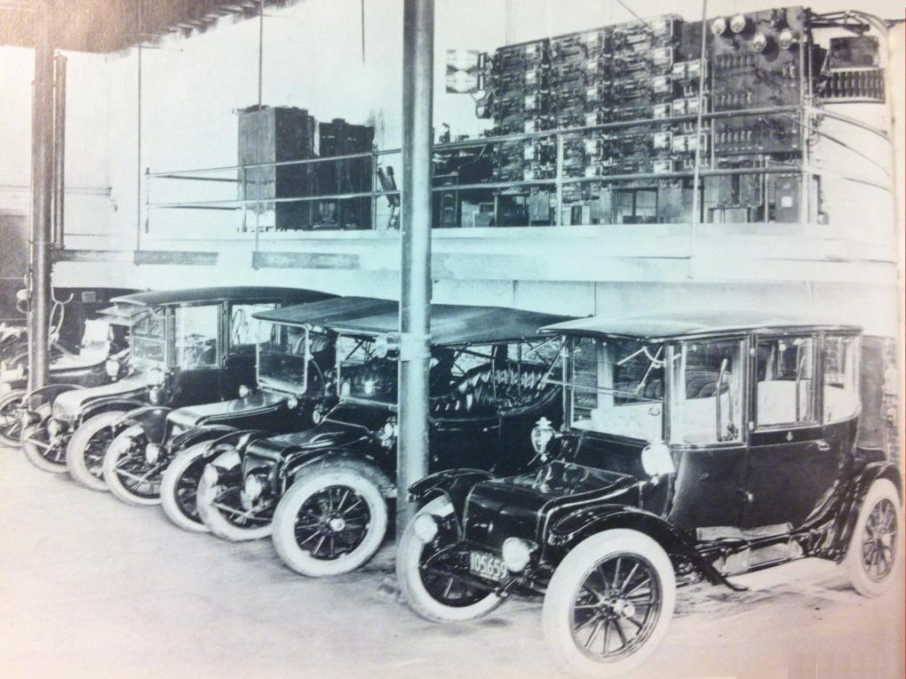
Early Milestones
1832-1839 Scottish inventor Robert Anderson invents the first crude electric carriage powered by non-rechargeable primary cells
1891 William Morrison of Des Moines, Iowa builds the first electric automobile in the US
1893 A handful of different makes and models of electric cars are exhibited in Chicago
1897 The first electric taxis hit the streets of NY City
1900 Of the 4,192 cars produced in the US 28% are powered by electricity
1915 Just shy of 50,000 electric vehicles in the US alone
Notes:
http://www.pbs.org/now/shows/223/electric-car-timeline.html

Slide 4
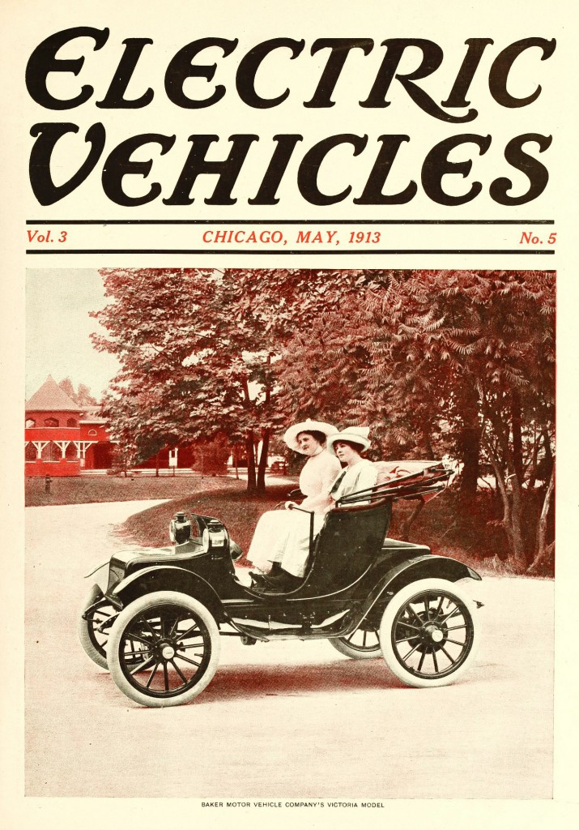

Slide 5
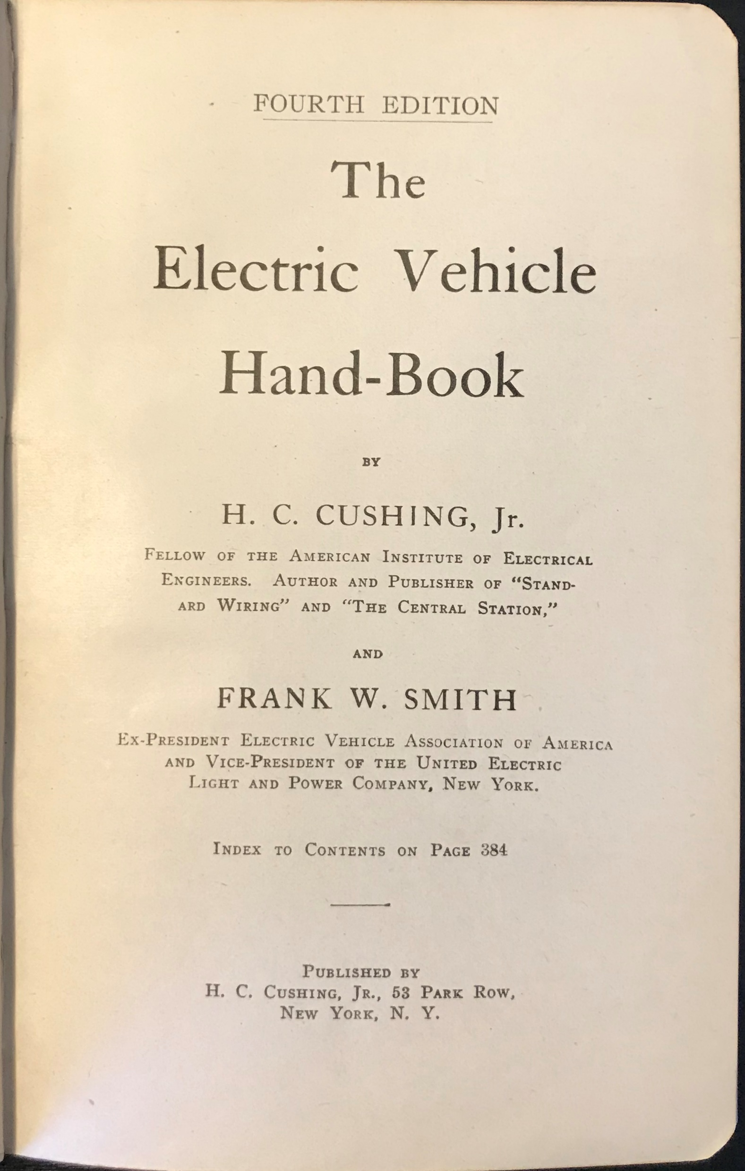
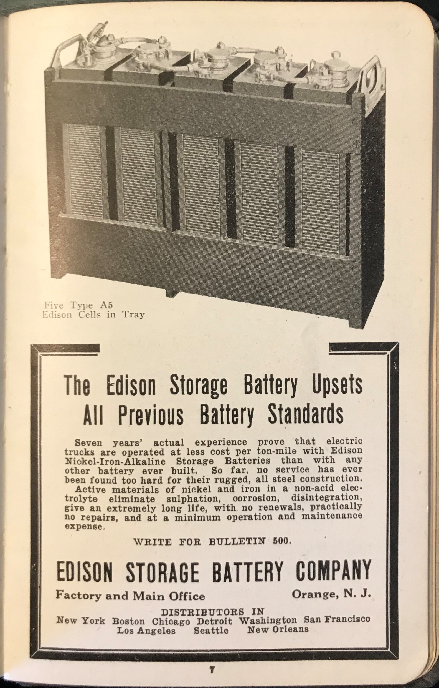

Slide 6
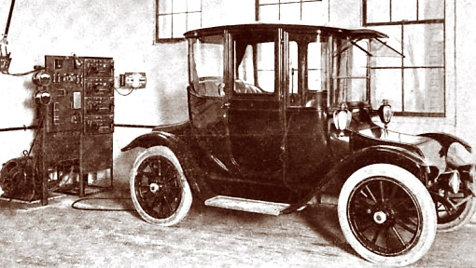

Slide 7
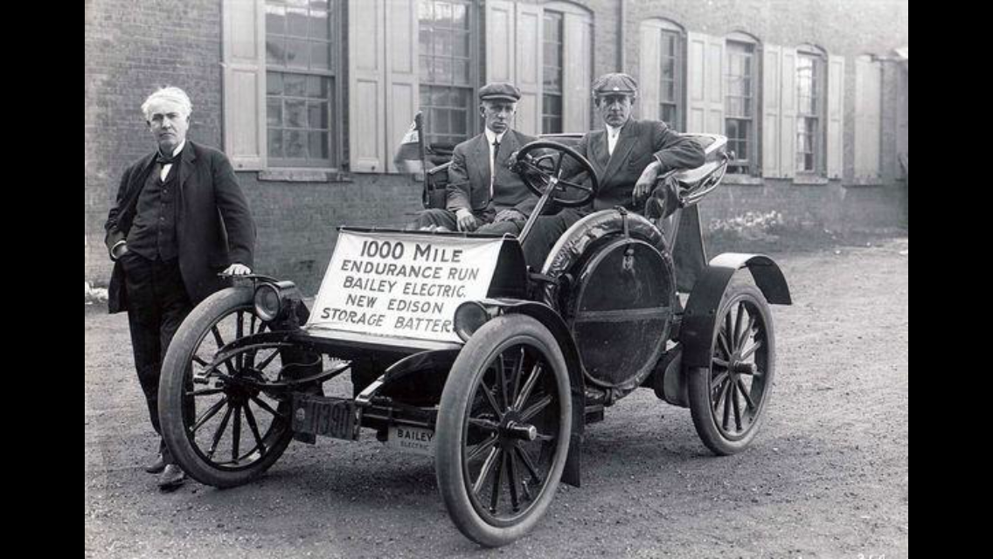

Slide 8
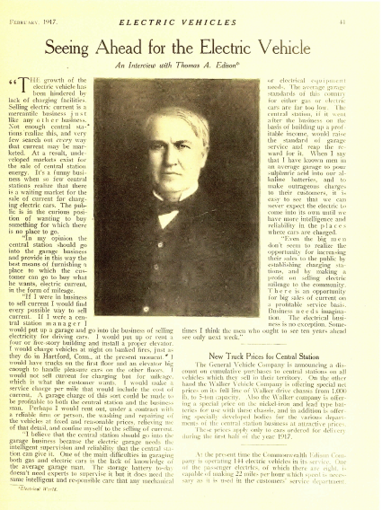
“The growth of the electric vehicle has been hindered by the lack of charging facilities.”
“It’s a funny business when so few central stations realize that there is a waiting market for charging electric cars. The public is in the curious position of wanting to buy something for which there is no place to go.”
There is an opportunity for big sales of current on a profitable service basis. Business needs imagination. The electrical business is no exception. Sometimes I think the men who ought to see ten years ahead see only next week.”

Slide 10
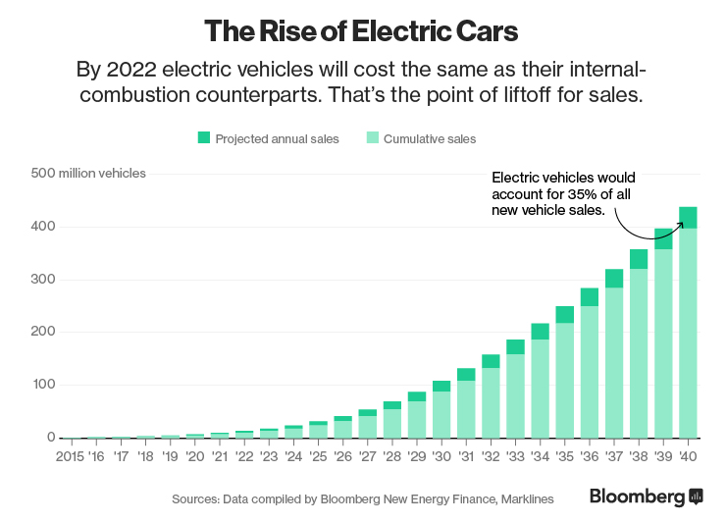
 | Population | Cars | % Car/Capital | EV cars | % EV / Total cars | New cars yearly | (New EV cars / New cars) yearly | New EV cars yearly
2019 | 7,6 billion (https://www.carsguide.com.au/car-advice/how-many-cars-are-there-in-the-world-70629) | 1,4 billion (https://www.carsguide.com.au/car-advice/how-many-cars-are-there-in-the-world-70629) | 18% | 2 million (Source: Frost Sullivan) | ~1% | 79 million (Source：Statista) | ~1% | <1 million
2040 | 9 billion (Source: Department of Economic and Social Affairs of the United Nations) | 2 billion (Source: Bernstein) | 22% | 300 million ÷ (Source: GlobalData) 400 million (Source: Bloomberg) | 15÷-25% | 115÷120 million | ~35% (Source: Bloomberg) | ~40 million

Slide 11
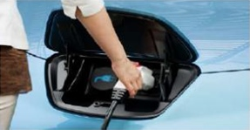
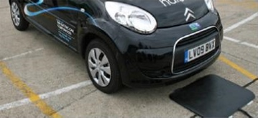
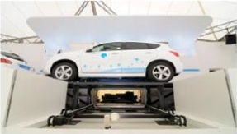
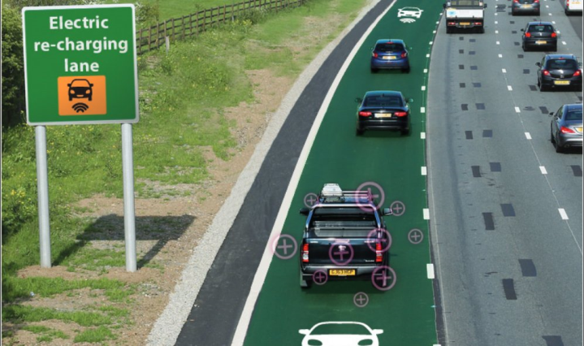
Charging Options
Option #1
Conductive Charging
Option #2
Wireless Power Transfer
Option #3
Continuous Wireless Charging

Slide 12
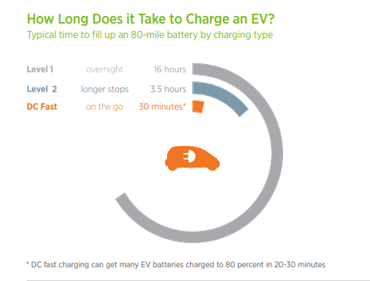
Courtesy of

Slide 13
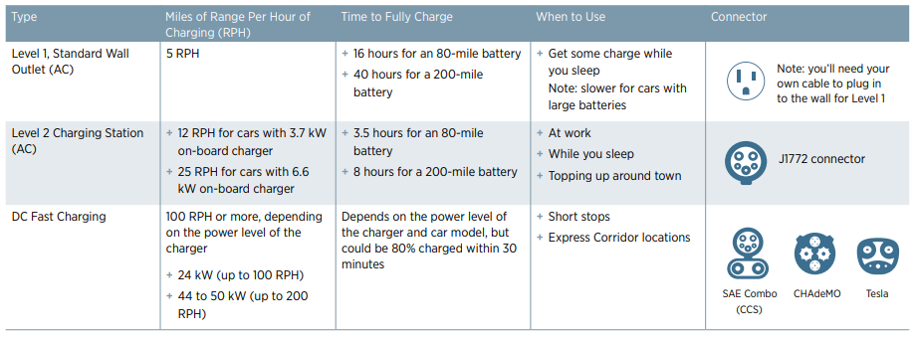
Courtesy of

Slide 14
EVSE Metrological Concerns
EVSEs in public spaces that bill customers for EV charged energy are regulated by National Conference of Weights and Measures (NCWM) Handbooks 130 and 44
Electricity is sold by kWh, or by kWh and time
Device type accuracy is 1%, field accuracy is 2%
EVSEs will start to be metrologically certified (accuracy and customer protection) beginning 2021
Notes:
This needs to be moved Process similar to gas stations.. CA Type Evaluation Program CTEP lab equipped for this testing

Slide 15
Where will charging take place?
Office Parking
Hotels
Public Parking
Shopping Mall
Public Parking
Home
It is estimated 80% of charging will take place at home
It is estimated 20% of charging will take place in public spaces (workplace, city streets, retail)
It is estimated there will need to be 3 charging stations for every EV in operation

Slide 16
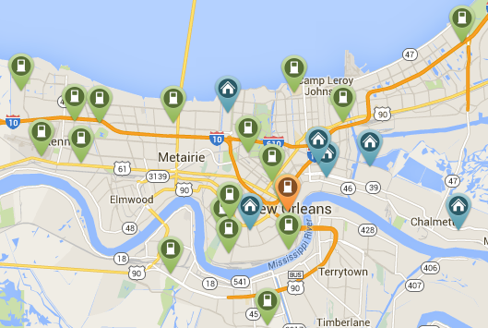
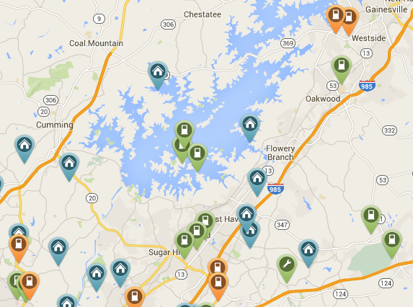
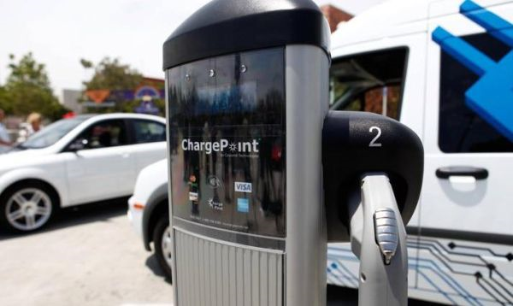
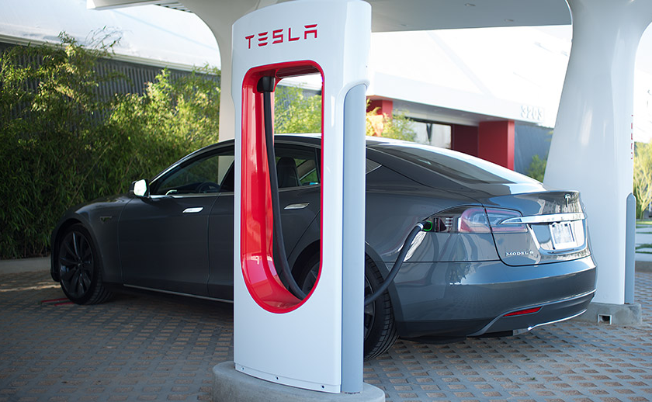
Number of Charging Stations in the US:
= 1,972
= 6,310
= 20,138
= 48,000
2020 = 70,000+

Slide 17
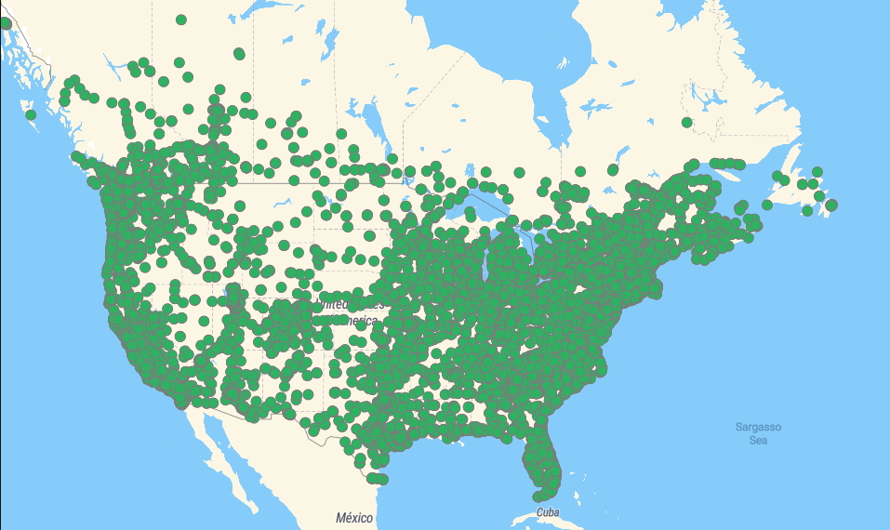
U.S. DOE Electric Vehicle Charging Station Locations
32,395

Slide 18
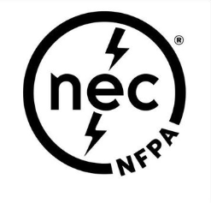
National Electrical Code
Article 625: Electric Vehicle Power Transfer Systems
General
Equipment Construction
Installation
Wireless Power Transfer Equipment

Slide 19
National Electrical Code
625.1 Scope. The provisions of this article cover the electrical conductors and equipment connecting an electric vehicle to premises wiring for the purposes of charging, power export, or bidirectional current flow.
Informational Note 1:
For industrial trucks, see NFPA 505-2018, Fire Safety Standard for Powered Industrial Trucks Including Type Designations, Areas of Use, Conversions, Maintenance, and Operations.
Informational Note 2:
UL 2594-2013, Standard for Electric Vehicle Supply Equipment, is a safety standard for conductive electric vehicle supply equipment.
UL 2202-2009, Standard for Electric Vehicle Charging System Equipment, is a safety standard for conductive electric vehicle charging equipment.

Slide 20
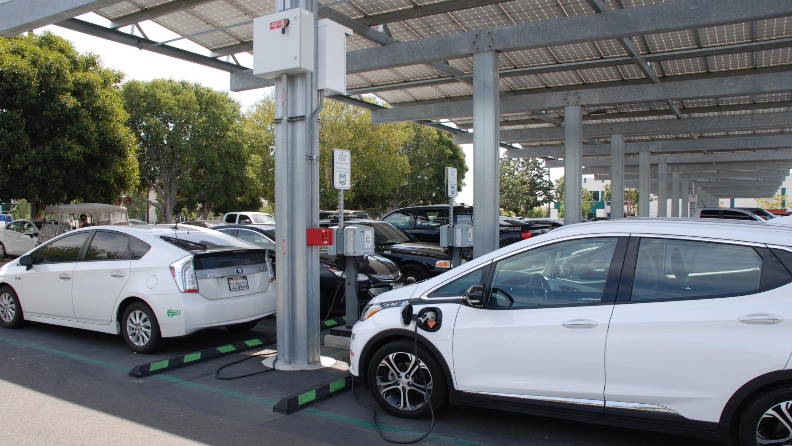
90.2(A) Scope
A new item (6) has been added to 90.2(A) to address installations used to export power from electric vehicles to premises wiring
Bidirectional flow of power is typically accomplished using utility interactive inverters

Slide 21
NEC 625.2 Definitions
Electric Vehicle Supply Equipment (EVSE).
The conductors, including the ungrounded, grounded, and equipment grounding conductors, and the electric vehicle connectors, attachment plugs, personnel protection systems, and all other fittings, devices, power outlets, or apparatus installed specifically for the purpose of transferring energy between the premises wiring and the electric vehicle.

Slide 22
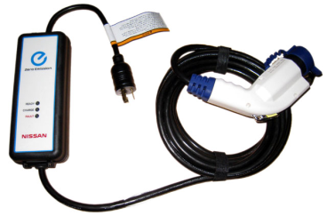
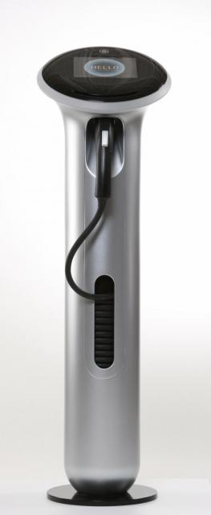
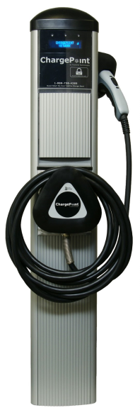
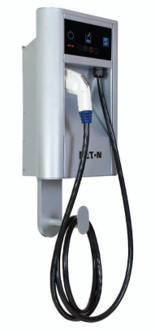
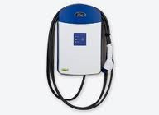
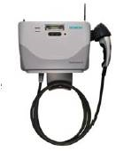
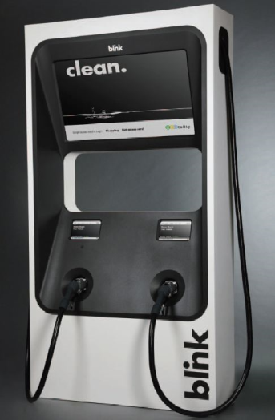
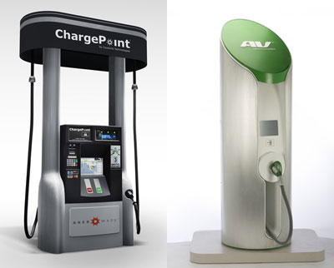
EVSE Types
Level 1
In the US, standard outlets are at 120 volts. All Level 1 charging is done at this voltage. Depending on the car and the level of charge on the battery, Level 1 charging can take 8 – 16 hours to charge. Level 1 charging would typically take place in the home. All new EVs will come with a Level 1 charging cord.
Level 2
Level 2 charging uses 208 or 240 volts and is able to fully charge a battery in 4 – 6 hours. This charge time is optimal for overnight or long-length charging. This is the preferred EV charging method for both public and private facilities. They will be typically found in public areas, parking garages and commercial businesses.
DC Fast Charging
DC Fast Charging and can provide 80% of a full charge in fewer than 30 minutes. They are the EV equivalent to the commercial gas station. These units are very expensive and require significant facilities and training. At this time exact voltage and load specifications for DC fast charging have not yet been defined. The vehicle must be properly equipped to accept a DC fast charge.

Slide 23
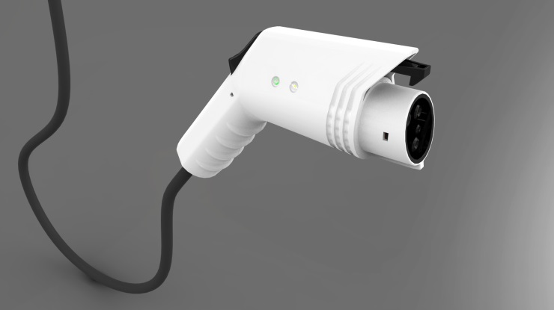
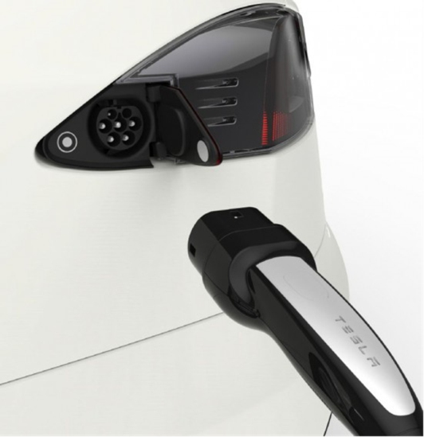
NEC 625.2 Definitions
Electric Vehicle Connector.
A device that, when electrically coupled (conductive or inductive) to an electric vehicle inlet, establishes an electrical connection to the electric vehicle for the purpose of power transfer and information exchange. This device is part of the electric vehicle coupler.
Informational Note: For further information, see 625.48 for interactive systems.

Slide 24
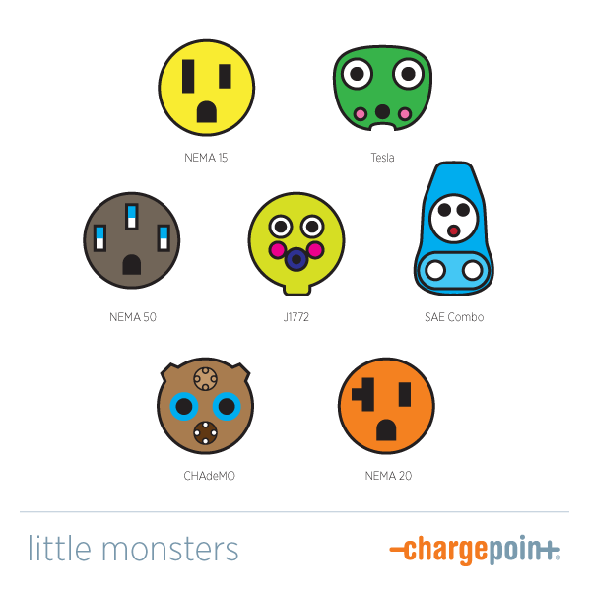
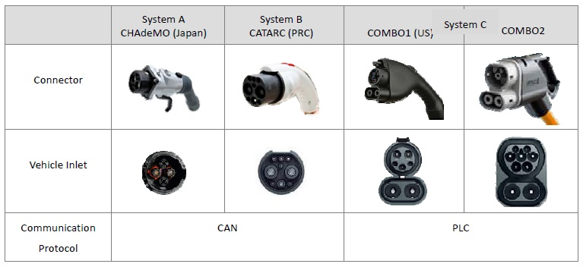
Connector Standards
Courtesy of

Slide 25
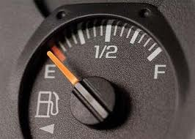
Knowing Where Your Fuel Tank Nozzle Is Has Become
A Little More Complicated

Slide 26
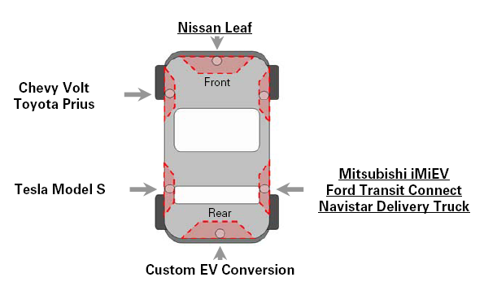
EV System – Charging Inlet Placement
North America Recommendation
Install Toward Front And Driver Side

Slide 27
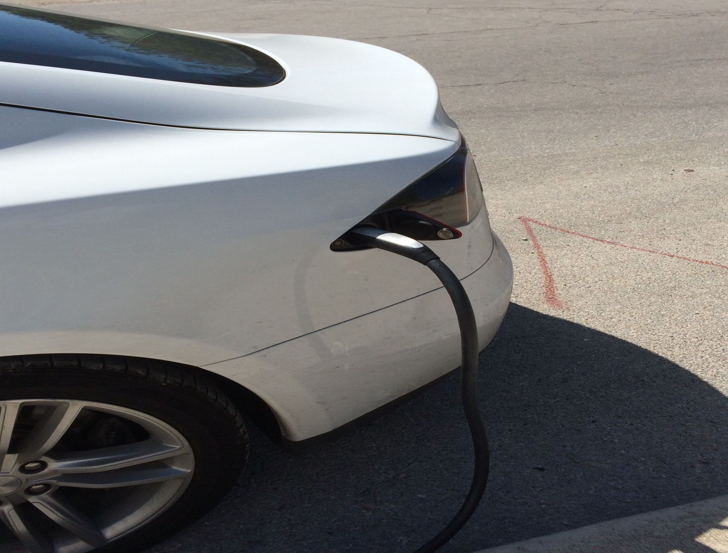

Slide 28
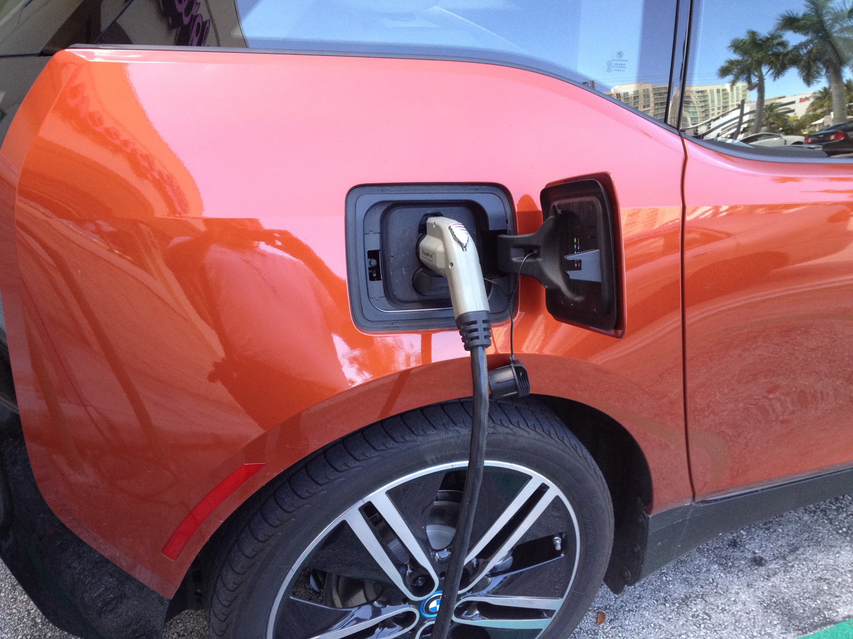

Slide 29
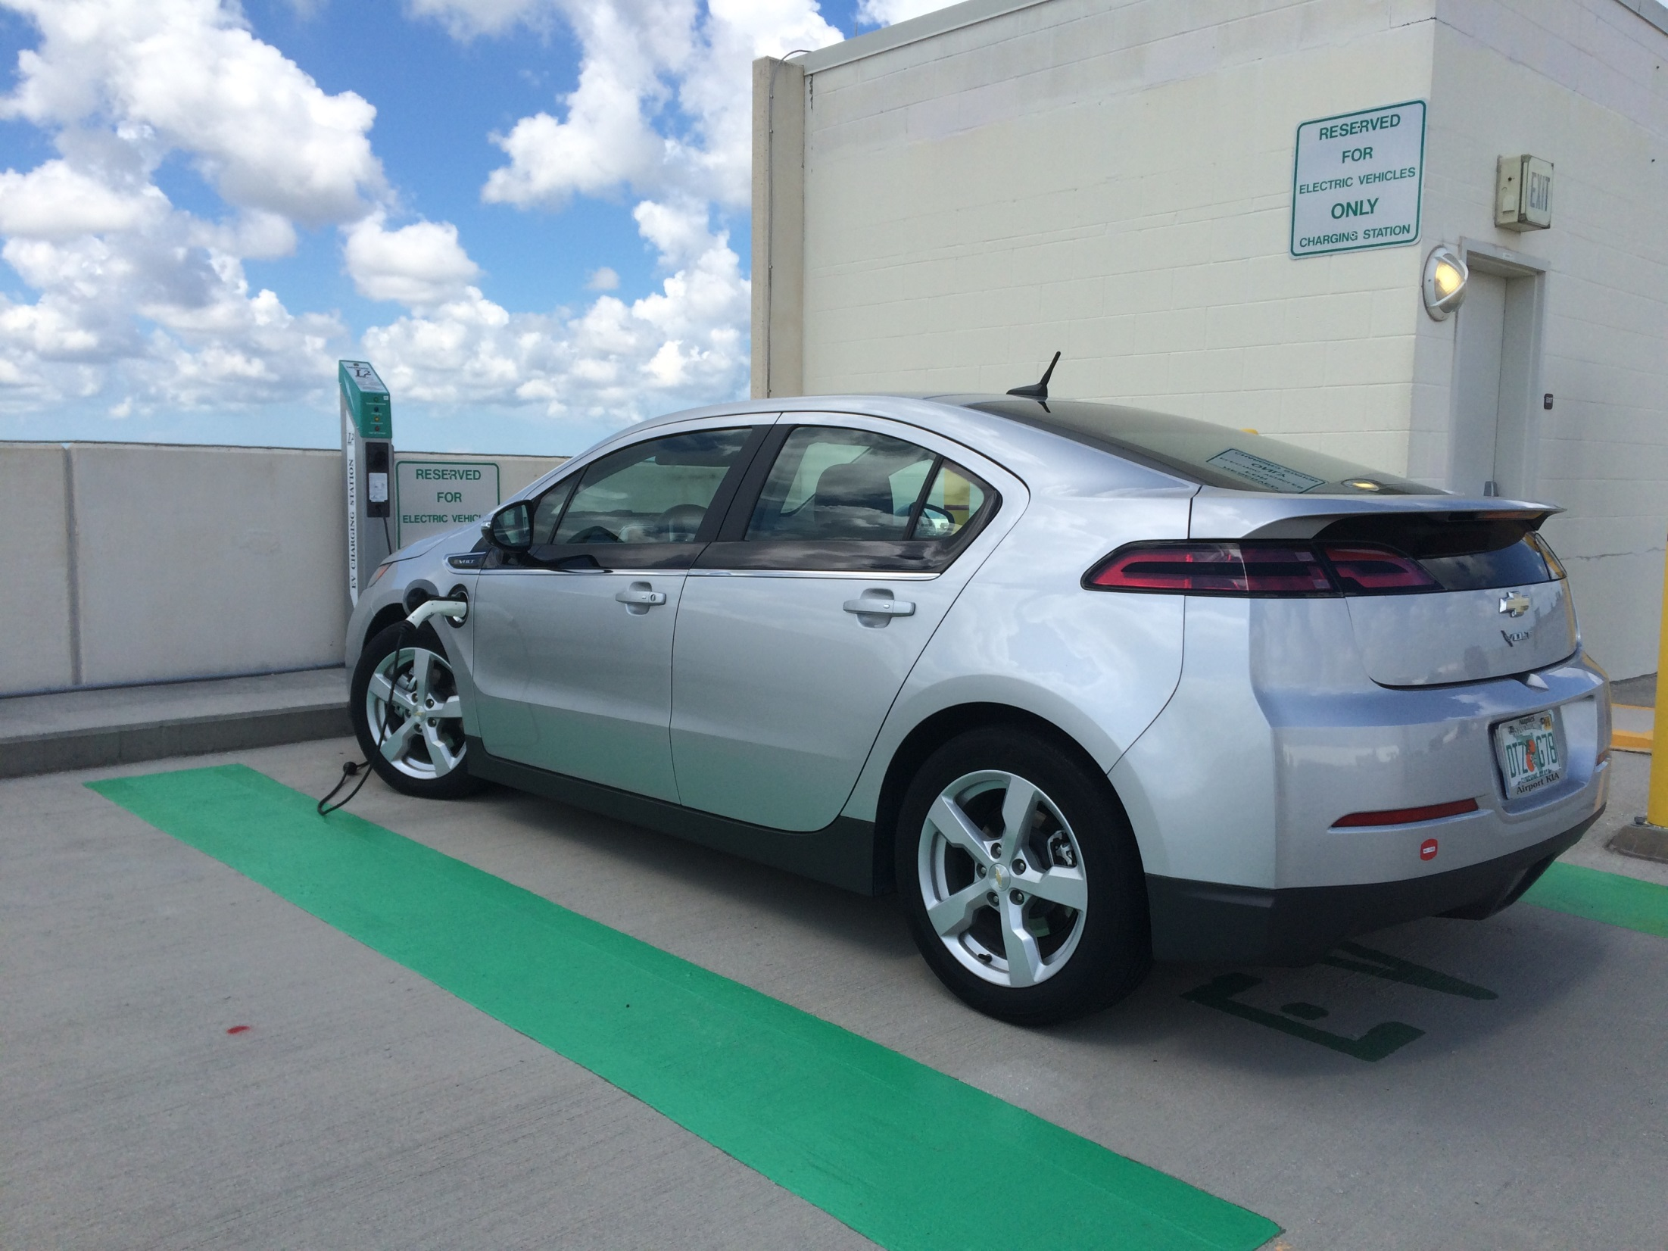

Slide 30
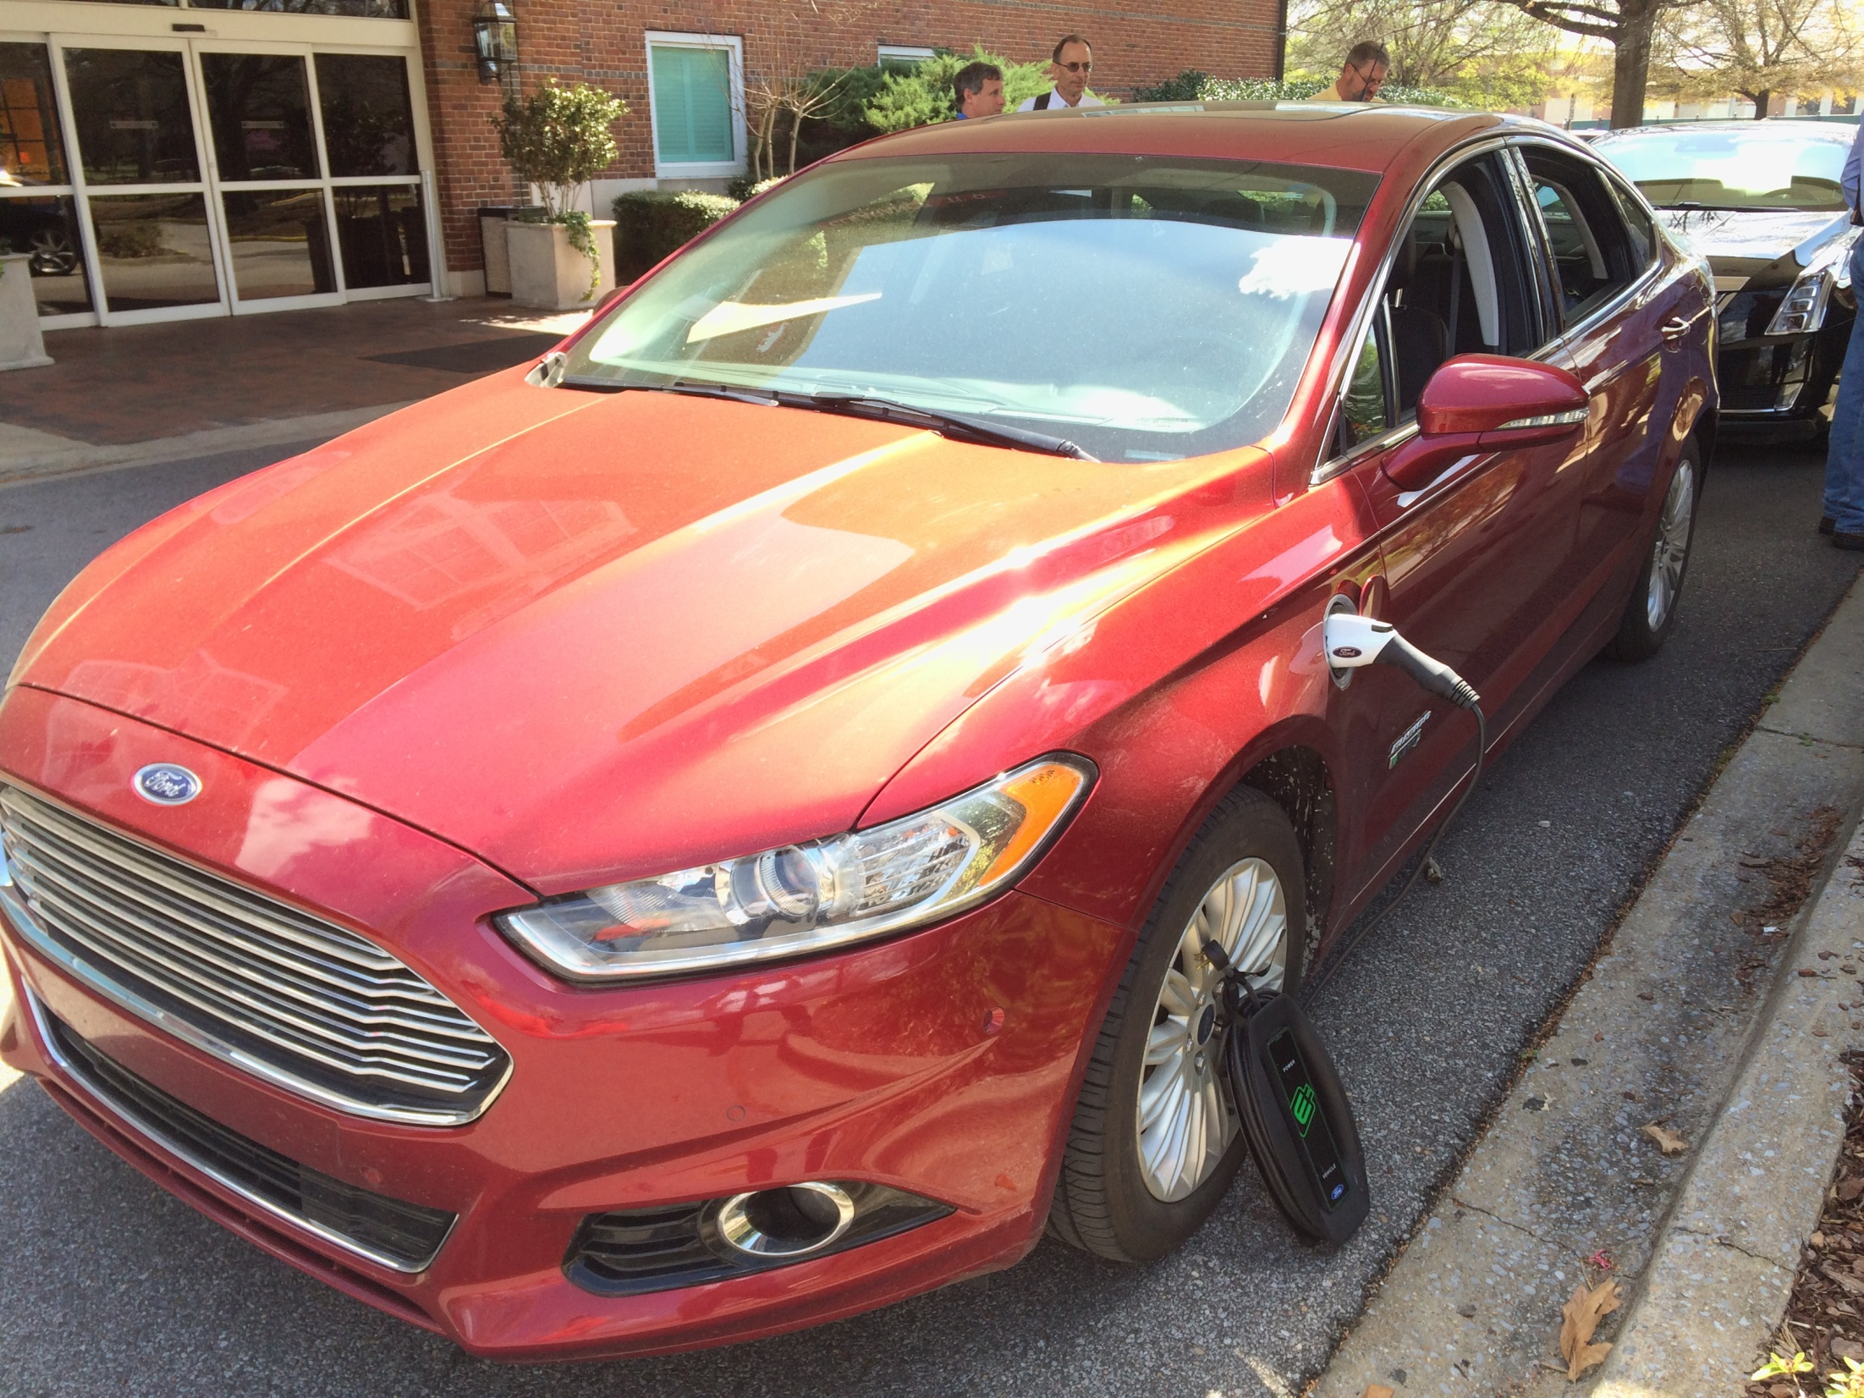

Slide 31
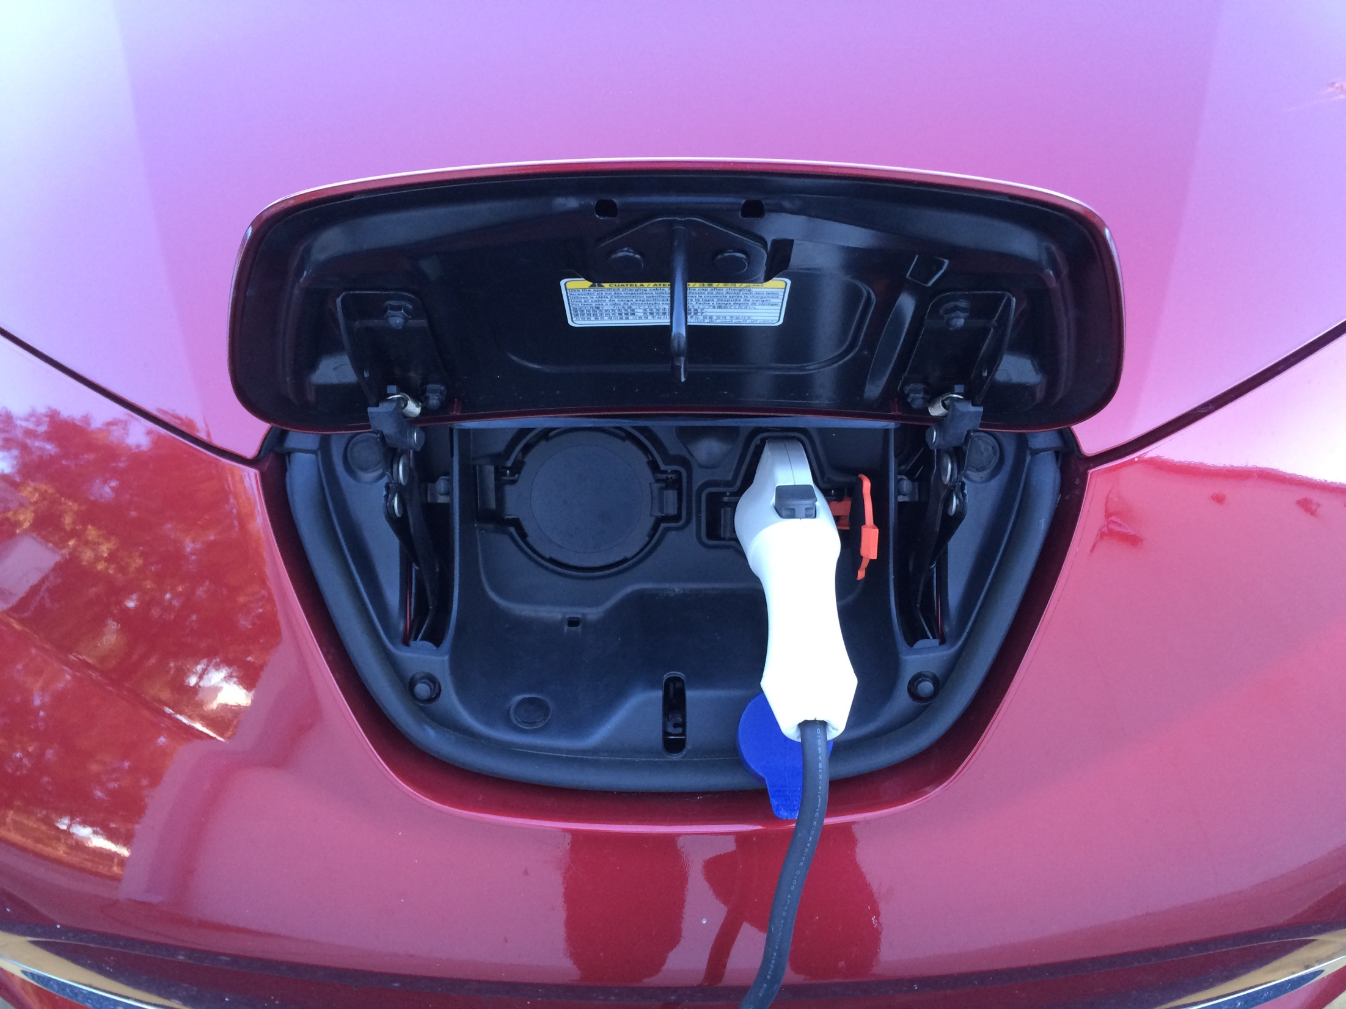

Slide 32
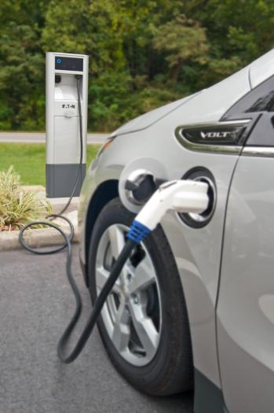
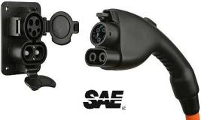
NEC 625.2 Definitions
Output Cable to the Electric Vehicle.
An assembly consisting of a length of flexible EV cable and an electric vehicle connector (supplying power to the electric vehicle).

Slide 33
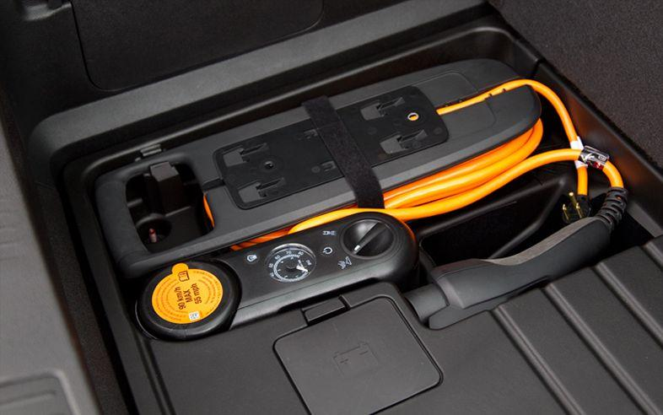
NEC 625.2 Definitions
Power-Supply Cord. An assembly consisting of an attachment plug and length of flexible cord that connects the electric vehicle supply equipment (EVSE) to a receptacle.
Chevy Volt cord-and-plug-connected equipment

Slide 34
NEC 625.5 Listed
All equipment covered by the scope of this article shall be listed.
UL Product iQ Category Codes:
FFTG: Electric Vehicle Charging System Equipment
FFSO: Electric Vehicle Cable
FFWA: Electric Vehicle Supply Equipment
FFYA: Electric Vehicle Wireless Power Transfer Equipment
FFTN: Electric Vehicle Bi-Directional Charging Systems

Slide 35
EVSE Codes & Standards
SAE
J1772™ – Charging system and connector for AC and DC
J2836™ – Charging communication use cases
J2836/1 – Utility / Smart Grid
J2836/2 – DC Charge Control
J2836/3 – Reverse Power Flow
J2836/4 – Diagnostics
J2836/5 – Consumer Interaction
J2847 – Charging communication messages
J2847/1 – J2847/5 – Mapped to J2836
J2931 – Charging communication protocol
J2931/1 – General Info
J2931/4 – Broadband PLC (HomePlug GP)
J2953 – PEV Interoperability with EVSE
NFPA 70 NEC, Article 625
FCC Part 15 – EMI
IEC
IEC 61851- EV conductive charging system
IEC 61980 – Wireless EVSE
IEC 62196 – Couplers
ISO/IEC 15118 Road vehicles —V2G Communication Interface
UL
UL2594 – AC Charging System
UL2202 – DC Charging System
UL2231 – Personnel Protection
UL 2251- Plugs, Receptacles and Couplers for Electric Vehicles*
UL1998 – Software Protection Systems
UL 62 – Flexible Cords and Cables (EV Cable)
UL2750 – EV Wireless Charging
NEMA
EVSE1- A Contactless RFID Credential for Authentication
IEEE
1547 – Interconnection of DER
P1901 – Broadband PLC
P2030.1 – Electric Transportation Infrastructure
NCWM
Hb130 - Method of Sale for Electricity as Vehicle Fuel
Hb44 - Device Code Requirements for Electric Vehicle Fueling - Electricity-Measuring Devices
NTEP Pub 14 - Electric Vehicle Fueling Systems Checklists • Test Procedures – type testing

Slide 36
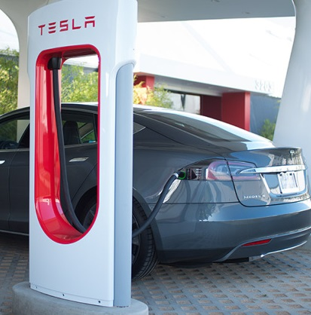
Part II. Equipment Construction
625.17 Cords and Cables.
(A) Power-Supply Cord:
Type EV, EVJ, EVE, EVJE, EVT, or EVJT
Ampacity in accordance with Table 400.5(A)(1)
Overall length where the personnel protection system is within the EVSE enclosure:
12 in. for portable equipment
6 ft. for stationary equipment
Overall length where the personnel protection system is located at the attachment plug or within the first 12 in. of the cord:
15 ft.

Slide 37
Part II. Equipment Construction
625.17 Cords and Cables.
(B) Output Cable to EV:
Type EV, EVJ, EVE, EVJE, EVT, or EVJT
An integral part of listed EVSE
(C) Overall Cord and Cable Length
The overall usable length shall not exceed 25 ft. unless equipped with a cable management system that is a part of the listed EVSE.

Slide 38
Part II. Equipment Construction
Personnel Protection System
625.2 Definitions
A system of personnel protection devices and constructional features that when used together provide protection against electric shock of personnel.
625.22 Personnel Protection System
The EVSE shall have listed system of protection against electric shock of personnel.
Cord-and-plug-connected EVSE require a personnel protection system in accordance with 625.17(A).
Personal Protective System
Loadcenter /
Supply
Penetration / Seal

Slide 39
EVSE – Personal Protection
UL 2231-1 “Personal Protection Systems for Electric Vehicle (EV)”:
Grounded Systems & Isolated Circuits
Charging circuit interrupting device (CCID)
Grounding monitor/interrupter
Isolation monitor/interrupter
UL 2231-2 “Personal Protection Systems for Electric Vehicle (EV) Supply Circuits: Particular Requirements for Protection Devices for Use in Charging Systems”
Personal Protective System
Loadcenter /
Supply
Penetration / Seal
Supply Circuits

Slide 40
Part III. Installation
625.40 Electric Vehicle Branch Circuit.
Each outlet installed for the purpose of charging electric vehicles shall be supplied by an individual branch circuit. Each circuit shall have no other outlets.
625.41 Overcurrent Protection.
Feeders and branch circuits supplying EVSE shall be sized not less than 125% of the maximum load of the EVSE.

Slide 41
Part III. Installation
625.43 Disconnecting Means
Readily accessible disconnect required for equipment rated more than 60 amperes.
Shall be lockable open in accordance with 110.25
625.44 Equipment Connection
(A) Portable Equipment
(4) receptacle configurations permitted
(B) Fastened-in-Place Equipment
(4) receptacle configurations permitted
(C) Fixed Equipment: Permanently Wired

Slide 42
Part III. Installation
625.47 Multiple Feeder or Branch Circuits.
Where equipment is identified for the application, more than one feeder or branch circuit shall be permitted to supply equipment.
This allowance is harmonized with the rules in Article 225 for outside branch circuits and feeders:
225.30(A) Special Conditions. Additional feeders or branch circuits shall be permitted to supply the following:
(7) Electric vehicle charging systems listed, labeled, and identified for more than a single branch circuit or feeder

Slide 43
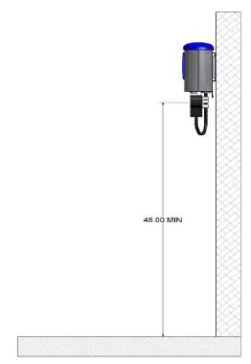
Mounting / Installation
Read The Manufacturer’s Installation Instructions
EVSE location requirements shall comply with 625.50.
Ventilation requirements for charging an EV in an indoor enclosed space shall comply with 625.52(A) of (B).
Height
18in. – 48in.

Slide 44
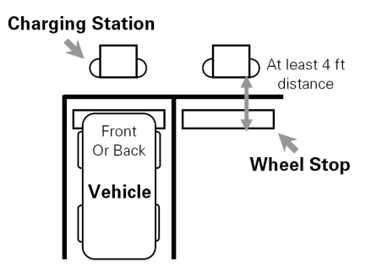
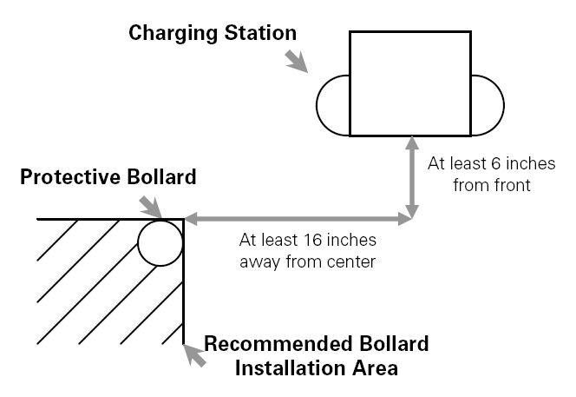
EV System – EVSE Placement
Protecting The Charging Station Is Important
Local Jurisdiction Requirements May Vary
Note: Bollard not required by NEC

Slide 45
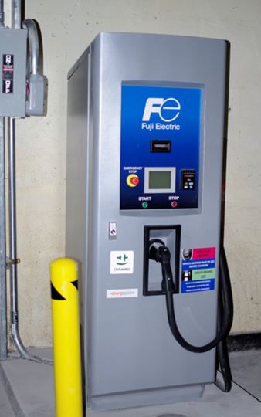
EVSE Installation
Bollard Protection – No Signage
Note: Bollard not required by the NEC
Notes:
Bollards not required by NEC

Slide 46
Federal Accessibility Requirements
Private Multifamily Residential Facilities
Fair Housing Act covered facilities are required to have public and common use areas readily accessible and usable by people with disabilities.
Fair Housing Act requires accessible and usable public and common use facilities to be on an accessible route from covered dwelling units
Although required to be accessible, no requirements specific to EV Charging Stations (EVCS) are specified in federal standards; guidance requires using ANSI A117.1 accessibility standards

Slide 47
Federal Accessibility Requirements
State and Local Government Facilities, Public Accommodations, and Commercial Facilities, under the Americans with Disabilities Act (ADA)
If available for use by the general public, the EVCS must be accessible to individuals with disabilities
No federal accessibility standards specific to the design of EVCS, even though accessibility to EVCS is required.
Lack of explicit scoping or technical requirements does not relieve ADA Title II and Title III entities from obligation to provide access.

Slide 48
Federal Accessibility Requirements
Key ADA EVSE Requirements
path of travel,
clearance in front of the equipment
height of the operable parts of the equipment (generally 48 inches max)
curb cuts and access aisle
wheelchair doesn’t have to roll over an output cord after plugged into the vehicle

Slide 49
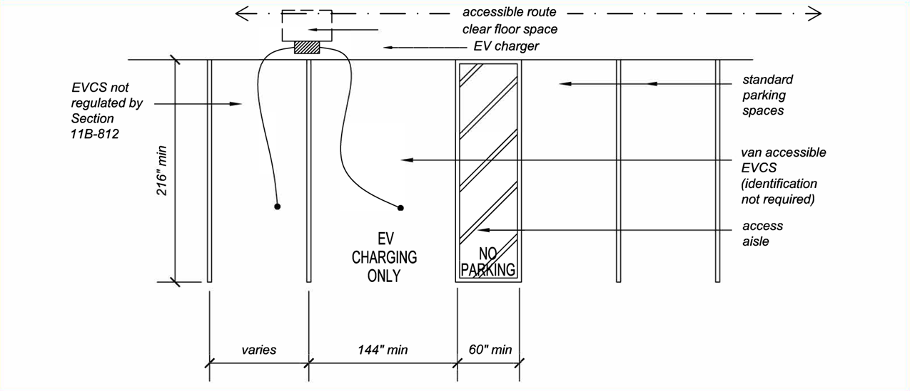
Federal Accessibility Requirements

Slide 50
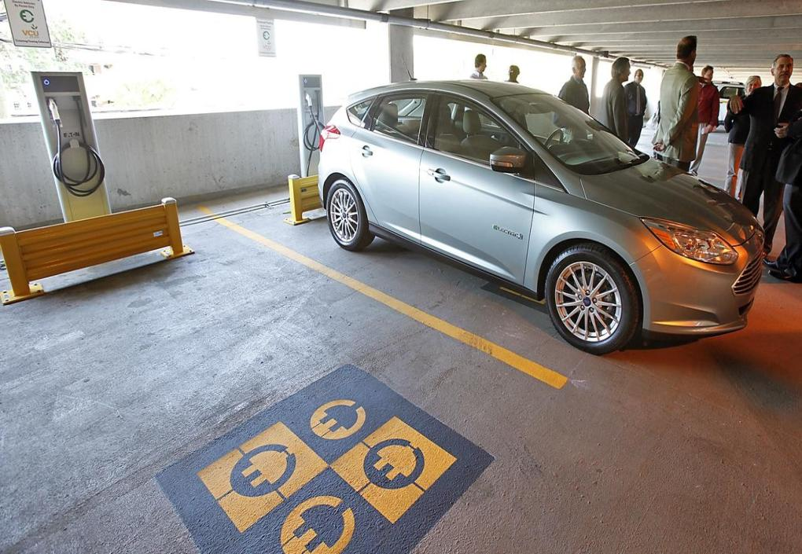
Chargers Are Well Protected
Spaces Are Labeled Similar To Handicapped

Slide 54
Part IV. Wireless Power Transfer Equipment
625.101 covers grounding requirements
625.102 covers WPTE Installation requirements:
(A) Type
(B) General
(C) Primary Pad
(D) Protection of Output Cable
(E) Other Wiring Systems

Slide 55
Frequently Asked Questions on EVSE
Does EVSE require working space &/or dedicated equipment space per the NEC?
How does EVSE impact energy calculations &/or load calculations? What about EVSE with adjustable settings or controllable EVSE?
Are ground rods required at EVSE?
Can EVSE be connected to a receptacle through an adapter?
Can EVSE be used as an Optional Standby System?
Are there any mandatory EV-Ready requirements?

Slide 56
NEC 110.26 – Working Space
Spaces About Electrical Equipment. Access and working space shall be provided and maintained about all electrical equipment to permit ready and safe operation and maintenance of such equipment.
EVSE is equipment rather than an appliance or utilization equipment.
110.26(E) Dedicated Equipment Space does not apply to EVSE installations.

Slide 57
International Energy Conservation Energy Code
R406.3 Energy Rating Index
Energy used to recharge or refuel a vehicle used for transportation on roads that are not on the building site shall not be included in the ERI reference design or the rated design.
C407.1 Total Building Performance
Exception: Energy used to recharge or refuel vehicles that are used for on-road and off-site transportation purposes.

Slide 58
NEC Load Calculations
Section 625.42:
Power transfer equipment shall have sufficient rating to supply the load served.
Electric vehicle charging loads shall be considered to be continuous loads.
Service and feeder shall be sized in accordance with product ratings.
Where an automatic load management system is used, the maximum electric vehicle supply equipment load on a service and feeder shall be the maximum load permitted by the automatic load management system.

Slide 59
NEC Load Calculations
Section 625.42:
Adjustable settings shall be permitted on fixed-in-place equipment only.
EVSE with restricted access to an ampere adjusting means shall be permitted to have ampere ratings that are equal to the adjusted current setting.
Sizing the service and feeder to match the adjusting means shall be permitted.
Restricted access shall prevent the user from gaining access to the adjusting means by at least one of the following:
(1) A cover or door that requires the use of a tool to open
(2) Locked doors accessible only to qualified personnel
(3) Password protected commissioning software accessible only to qualified personnel

Slide 60
Controllable EVSE
Can be connected to a cloud-based management system, controlled locally or stand-alone (contained in the EVSE)
Can include energy/load management, access control, usage tracking, data presentment, usage billing, POS revenue collection, etc.
Can set total system capacity across one or multiple EVSE
Can set capacity based on time of day

Slide 61
Grounding Electrode System Required at EVSE
250.32(A) = Buildings or structures supplied by feeders or branch-circuits shall have a grounding electrode system installed…
Article 100:
Building = A structure that stands alone or that is separated from adjoining structures by fire walls.
Structure = That which is built or constructed, other than equipment.

Slide 62
EVSE Connected by Adapters
The NEC is essentially silent on the question of adapter use:
- Avoid unlisted, generic, or universal adapters.
- Follow the manufacturer’s installation instructions.

Slide 63
Interactive EVSE as Standby Equipment
625.48 Interactive Systems. EVSE that incorporates a power export function and that is part of an interactive system that serves as an optional standby system, an electric power production source, or a bidirectional power feed shall be listed, evaluated for use with the specific electric vehicles, and marked as suitable for that purpose.
When used as an optional standby system, the requirements of Article 702 shall apply.
When used as an electric power production source, the requirements of Article 705 shall apply.

Slide 64
Mandatory EV-Ready Requirements
Several states (California, Colorado, New York) have mandatory EV-Ready requirements
Several municipalities, community improvement districts, and other jurisdictions have mandatory EV-Ready requirements
SWEEP List of Municipalities and States With EV-Ready Building Codes

Slide 65
SUMMARY
EV and EVSE technology has been evolving for more than 100-years and will continue to evolve into the next century.
The rapid electrification of transportation will significantly increase the prominence and importance of Article 625 and EVSE Standards.
EVSE installations in compliance with the NEC and manufacturer’s installation instructions ensure safety from shock, electrocution, and fire.

Slide 69
Thank You For Your Participation!
Questions?
SOUTHERN REGION Bryan Holland 130 Duxbury Ave. Port Charlotte, FL 33952 Mobile: (972) 358-0543 bryan.holland@nema.org | MIDWEST REGION Tim McClintock 11813 Township Road 516 Shreve, OH 44676 Mobile: (330) 749-9782 tim.mcclintock@nema.org
NORTHEAST REGION Jack Lyons 12 Ireland Street Ext. West Chesterfield, MA 01084 Mobile: (413) 695-2869 jack.lyons@nema.org | WESTERN REGION Mike Stone 10394 Old Dobbins Road P.O. Box 227 Dobbins, CA 95935 Mobile: (707) 495-8424 mike.stone@nema.org

