Slide 1
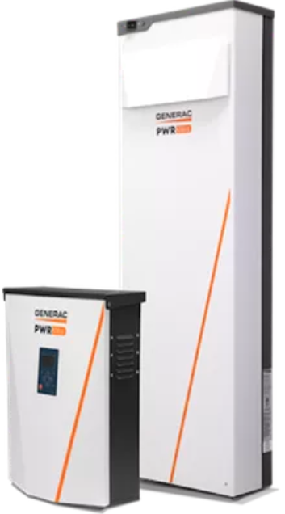
Residential Energy Storage & PCS
Systems

Slide 2
Outline
AC🗲DC Batteries Key Differences Common AC Batteries
Common DC Batteries
Disconnecting Means AC Disconnects DC Disconnects Remote Disable Switches
🗲Power Control Systems🗲 Code Updates
Common Examples

Slide 3
Alternating Current Energy Storage Systems
Direct Current Energy Storage Systems
Instantly available backup power
Internal inverters store energy as DC, but deliver it as AC
Easier to install
More compatible with existing solar
Each battery backfeeds independently
Battery faults won’t effect PV system & vice versa
Not charged by solar if depleted & off grid
Require Separate Inverter to convert electricity for home use
Typically more efficient charging & storage
Typically less expensive
Fully integrated with PV system
Backfeed limited by inverter regardless of system size
Charged by solar even if depleted & off grid

Slide 4
Tesla Powerwall
Enphase Encharge
Sonnen ecoLinx

Slide 5
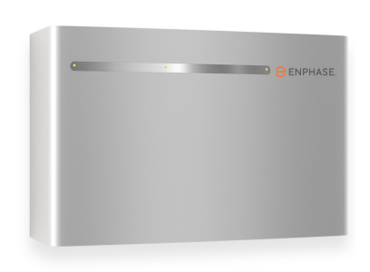
Enphase IQ Battery 10
Capacity: 10.5 kWh
Continuous AC Output: 16 A
Transfer Switch:
Connected MID
200A
Automatic
PCS Functionality when paired with Envoy
Full Scale Fire Tested - 3’ Spacing Exempt with recommended wall mount

Slide 6
Tesla Powerwall
Capacity: 14 kWh
Continuous AC Output: 30A
Transfer Switch:
Connected Site Controller
200A
Automatic
PCS Functionality when paired with Gateway
Full Scale Fire Tested - 3’ Spacing Exempt

Slide 7
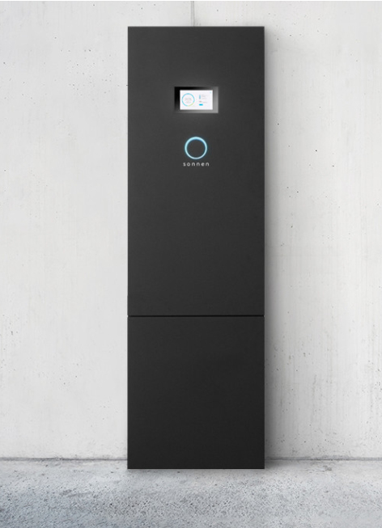
Sonnen ecoLinx
Capacity: 10 to 20 kWh
Modular
Continuous AC Output: 30A
Transfer Switch:
200A
Automatic
Integrated
PCS Functionality

Slide 9
Generac PWR Cell
Capacity: 9 - 17.1 kWh
Modular (up to 6 modules)
Transfer Switch:
Connected MID
200A
Automatic
PCS Functionality when paired with Inverter

Slide 10
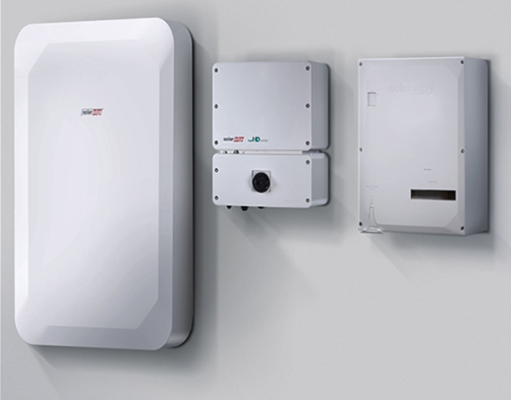
Capacity: 10 kWh
Continuous AC Output: 16 A
Transfer Switch:
Connected MID
200A
Automatic
PCS Functionality when paired with Inverter

Slide 11
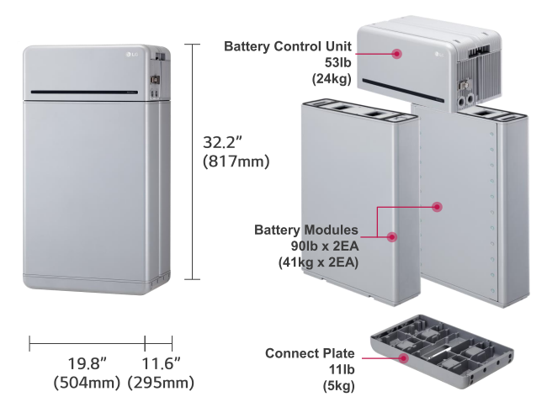
Capacity: 9.8 kWh
Transfer Switch:
Connected MID (BUI)
200A
Automatic
Internal Breaker
No UL 9540A Listing

Slide 12
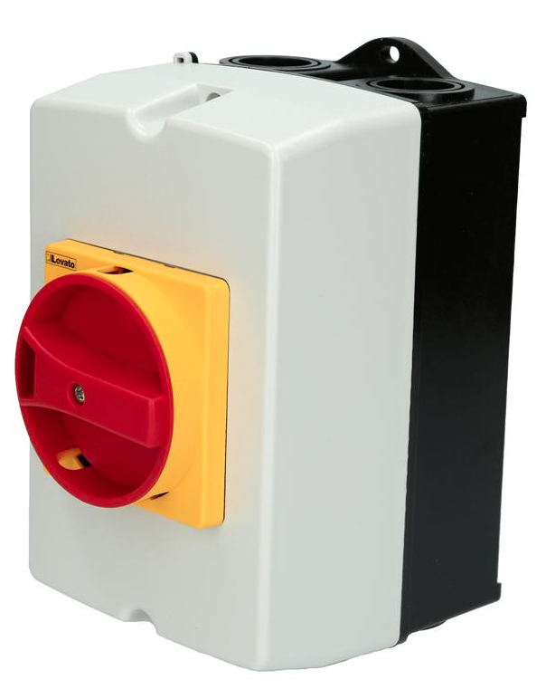
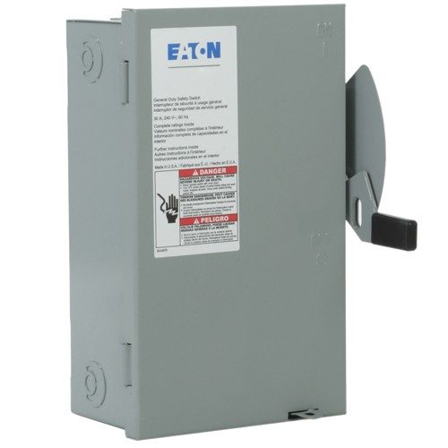
Disconnecting Means
Design considerations when placing disconnects matter
Because of the nature of Energy Storage Systems, disconnects may not de-energize where intended
AC-Coupled systems & DC-Coupled Systems behave differently
Redundancy is the enemy of simplicity is the enemy of execution

Slide 13
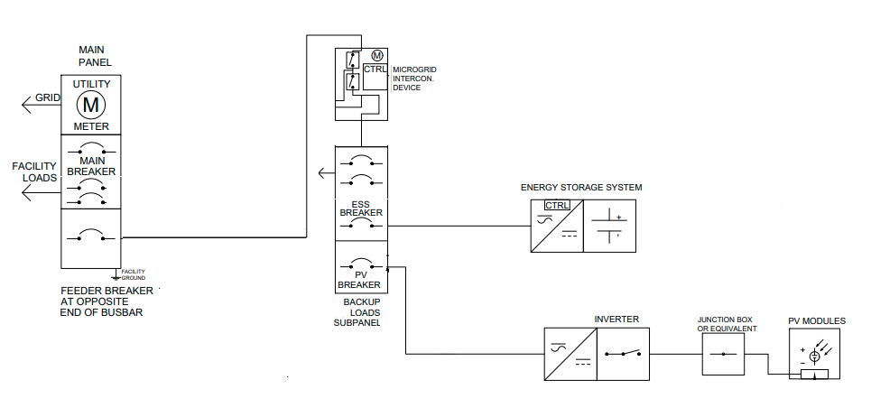
Typical Line Diagram for AC Battery Backup

Slide 14
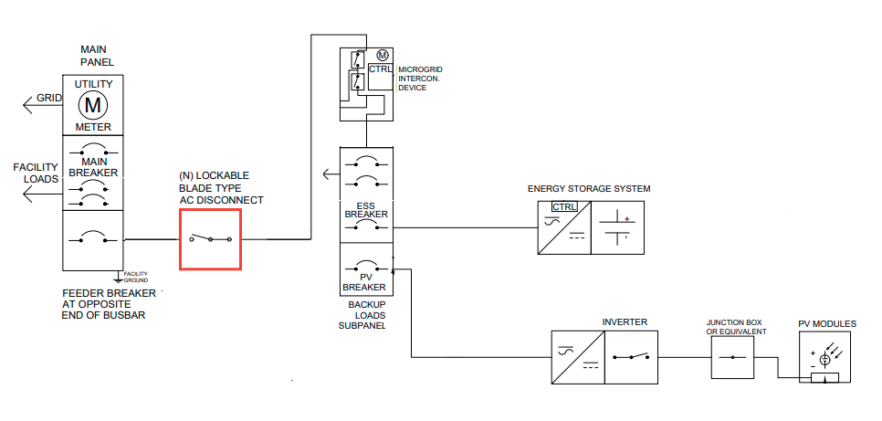
Disconnect between the Main Utility Panel & the MID will not De-Energize anything anything on its own

Slide 15
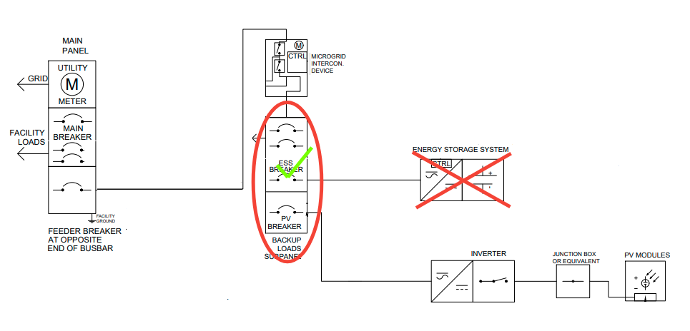
The AC Battery breaker is most effective means of disconnect for an AC Battery Backup

Slide 16
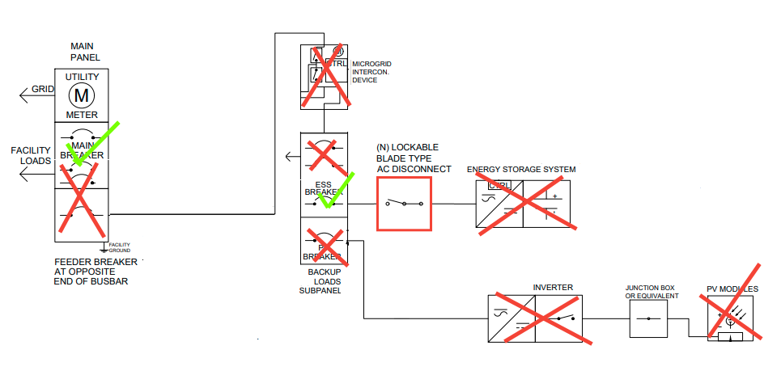
Disconnect Main Breaker + ALL AC Battery connections to fully De-Energize Home

Slide 17
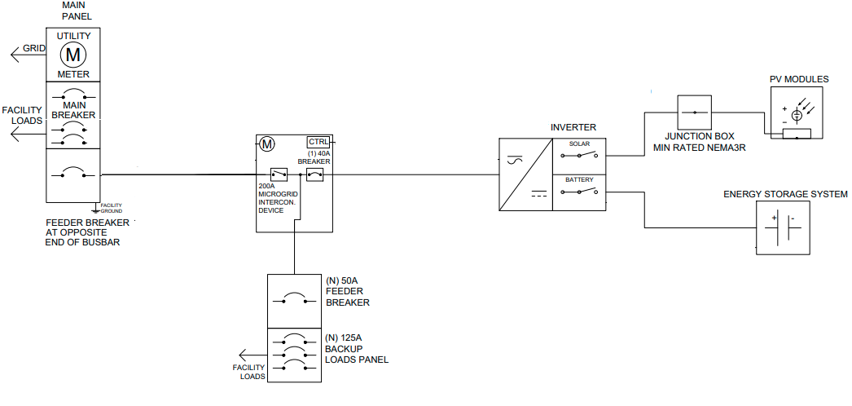
Typical Line Diagram for DC Battery Backup

Slide 18
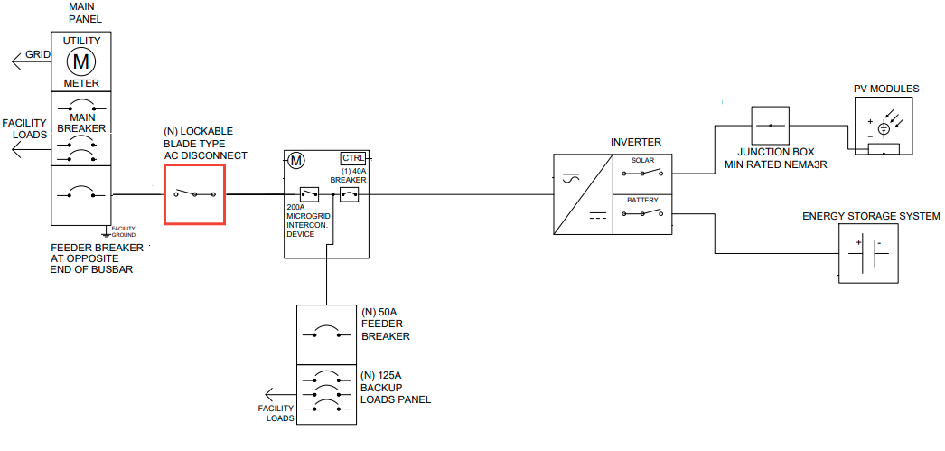
Disconnect between the Main Utility Panel & the MID will not De-Energize anything anything on its own

Slide 19
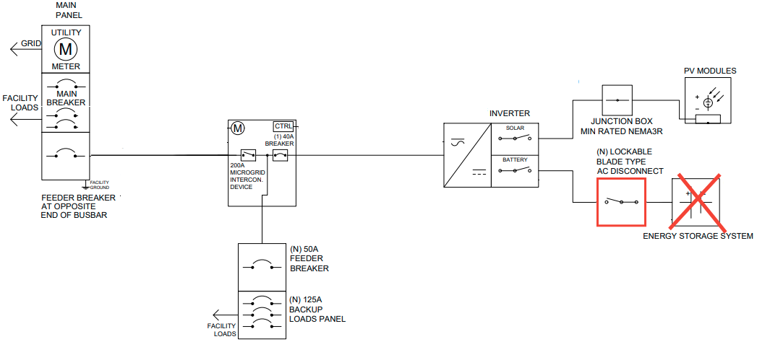
Disconnect between the Inverter & the Battery will not De-Energize anything

Slide 20
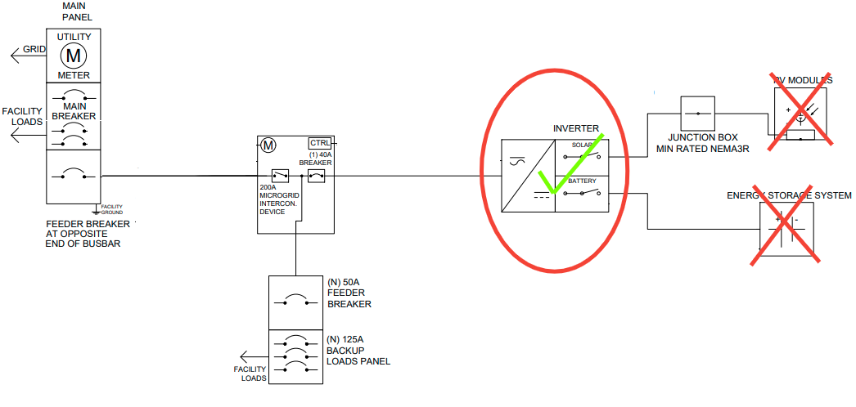
The Inverter is the most effective means of disconnect for a DC Battery Backup

Slide 21
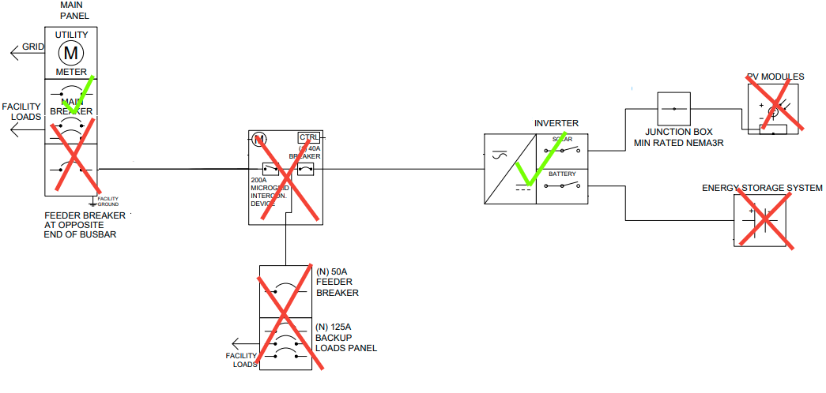
Disconnect Main Breaker + Inverter to fully De-Energize Home

Slide 22
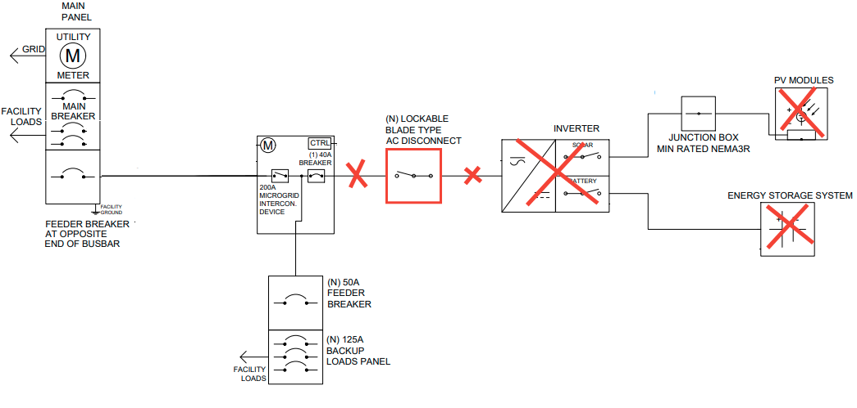
Disconnect between the MID & the Inverter will effectively Disconnect the Inverter

Slide 23
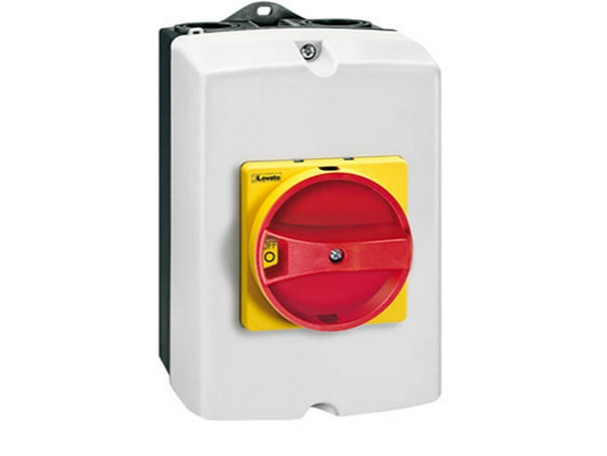
Remote Disable Switch
Pros
Disables ALL devices connected to MID with one switch
Easily Placed near Main Utility Panel
Typically highly visible
Cons
Indirect Disconnect
Subject to firmware updates & bugs
Comm wire can be easily damaged

Slide 24
Power Control
Systems

Slide 25
What is a Power Control System?
Power Control Systems (PCS) Monitor and regulate output of production sources, energy storage systems, and other equipment to limit the current and loading on busbars and conductors supplied by the PCS.
PCS functionality can be integrated into Site Controllers, Inverters, Energy Storage Systems and Microgrid Interconnection Devices (MID)

Slide 26
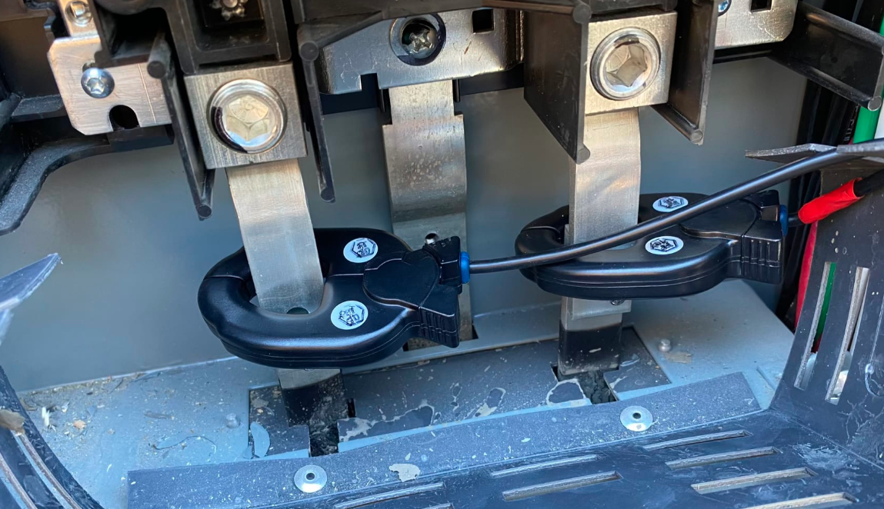
Code Updates
705.13(A) - Monitoring. The PCS controller shall monitor all currents within the PCS. Any busbar or conductor on the load side of the service disconnecting means that is not monitored shall comply with 705.12. Where the PCS is connected in accordance with 705.11, the PCS shall monitor the service conductors and prevent the overload of these conductors

Slide 27
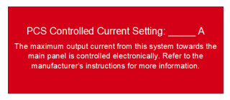
Code Updates
705.13(B) - Settings. The sum of all PCS-controlled currents plus all monitored currents from other sources of supply shall not exceed the ampacity of any busbar or conductor supplied the power production sources. Where the PCS is connected to an overcurrent device protecting any busbar or conductor not monitored by the PCS, the setting of the PCS controller shall be set within the ratings of that overcurrent device.

Slide 28
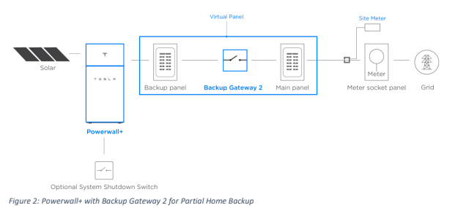
Code Updates
705.13(C) - Overcurrent Protection. The PCS shall provide overcurrent protection either by overcurrent devices or by the PCS including the functionality as an overcurrent device in the product listing

Slide 29
Code Updates
705.13(D) - Single Power Source Rating. The rating of the overcurrent device for any single power source controlled by the PCS shall not exceed the rating of the busbar or the ampacity of the conductors to which it is connected

Slide 30
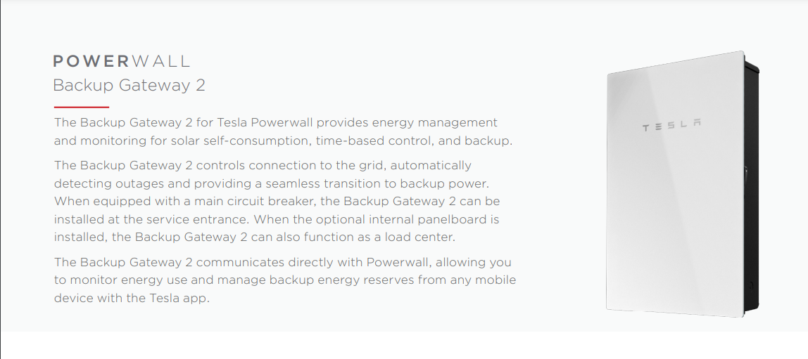

Slide 31
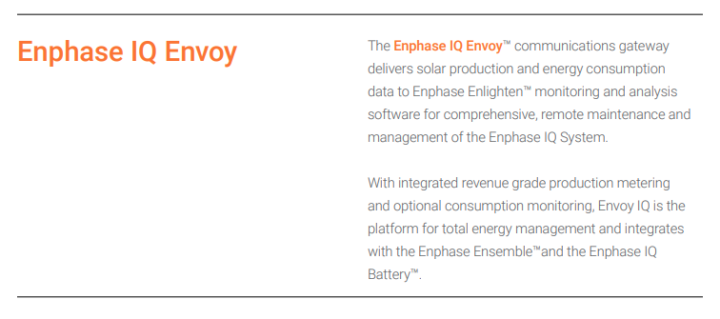
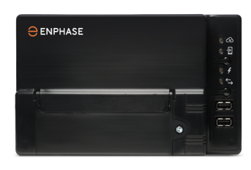

Slide 33
References
CA PCS List
Tesla PCS Compliance Letter (Available through Tesla Partner Portal)
Tesla Powerwall Spec Sheet
Tesla Gateway 2 Spec Sheet
Sonnen ecoLink Specsheet
Generac PWRcell Inverter Spec Sheet
Enphase Battery Spec Sheet
Enphase Empower MID Spec Sheet
Enphase Envoy Communication Gateway Spec Sheet
Enphase Mounting Requirements
SolarEdge EnergyBank Spec Sheet
https://www.lgessbattery.com/us/home-battery/product-info.lg
NFPA 70 NEC 2020

